Slide 1
Voice of America
Mandarin Journey Map

Slide 2

Welcome Splash
Business Goals
Keep users engaged
Establish placement of Psiphon status indicator
Individual Perspective
Personas
All
Time in Journey
0 to 3 seconds
Emotion
FOMO
Anticipation
Expectations
Tasks / Goals
Find out the latest news
Get informed on breaking news
Thinking
Can I get what I need quickly?
Does VOA have the news I’m looking for?
Heuristics
Safety – I’m not tracked by the government
Confidence – I can get the news I want
Delight – I enjoy getting the news from this app
Software Perspective
Psiphon Connection
Immediately connect through Psiphon and reflect status
Interactions
Wait 3 seconds for Welcome Splash to fade to Home screen OR
Tap or swipe left to get to Home screen
Photo blurs and fades behind news cards
Affordances
See a new photo each day
Hear the screen fade to the home screen
Business Perspective
Hypothesis
Users want basic information when they first open the app:
Circumvention status
Current date
Business Value
Give users confidence that they’re getting authoritative, high-quality news
Fosters the ideals of freedom and democracy
Metrics This Will Support
Retention
Bounce rate

Slide 3

Home Screen
Individual Perspective
Personas
All
Time in Journey
3 to 8 seconds
Emotion
FOMO
Anticipation
Expectation
Tasks / Goals
Find out about the latest news
Get informed on breaking news
Thinking
Where is the update I’m looking for?
Heuristics
Useful – I’m getting the right news
Controllable – I know how to find what I’m looking for
East of Use – It’s easy to get what I want
Software Perspective
Psiphon Connection
If connection is lost, show cached content for a set amount of time
Interactions
Scroll up for more content
Click into a story
Scroll down to reveal Search
Click Categories / Manage Categories
Scroll left / right to see more Categories
Click content
Click for different content types and user settings
Affordances
See available content
Hear content playing in multimedia player
Feel vibration when Psiphon is lost
Business Perspective
Hypothesis
Users are happy with the prioritization they configure and see
Users can easily figure out how to change their category prioritization
Business Value
Quickly give users the most up to date news headlines
Metrics This Will Support
Adoption
Retention
Business Goals
Keep users engaged
Minimize the number clicks to get users to the news they want

Slide 4


Home Screen Swipes
Swipe Up
Swipe Down

Slide 5

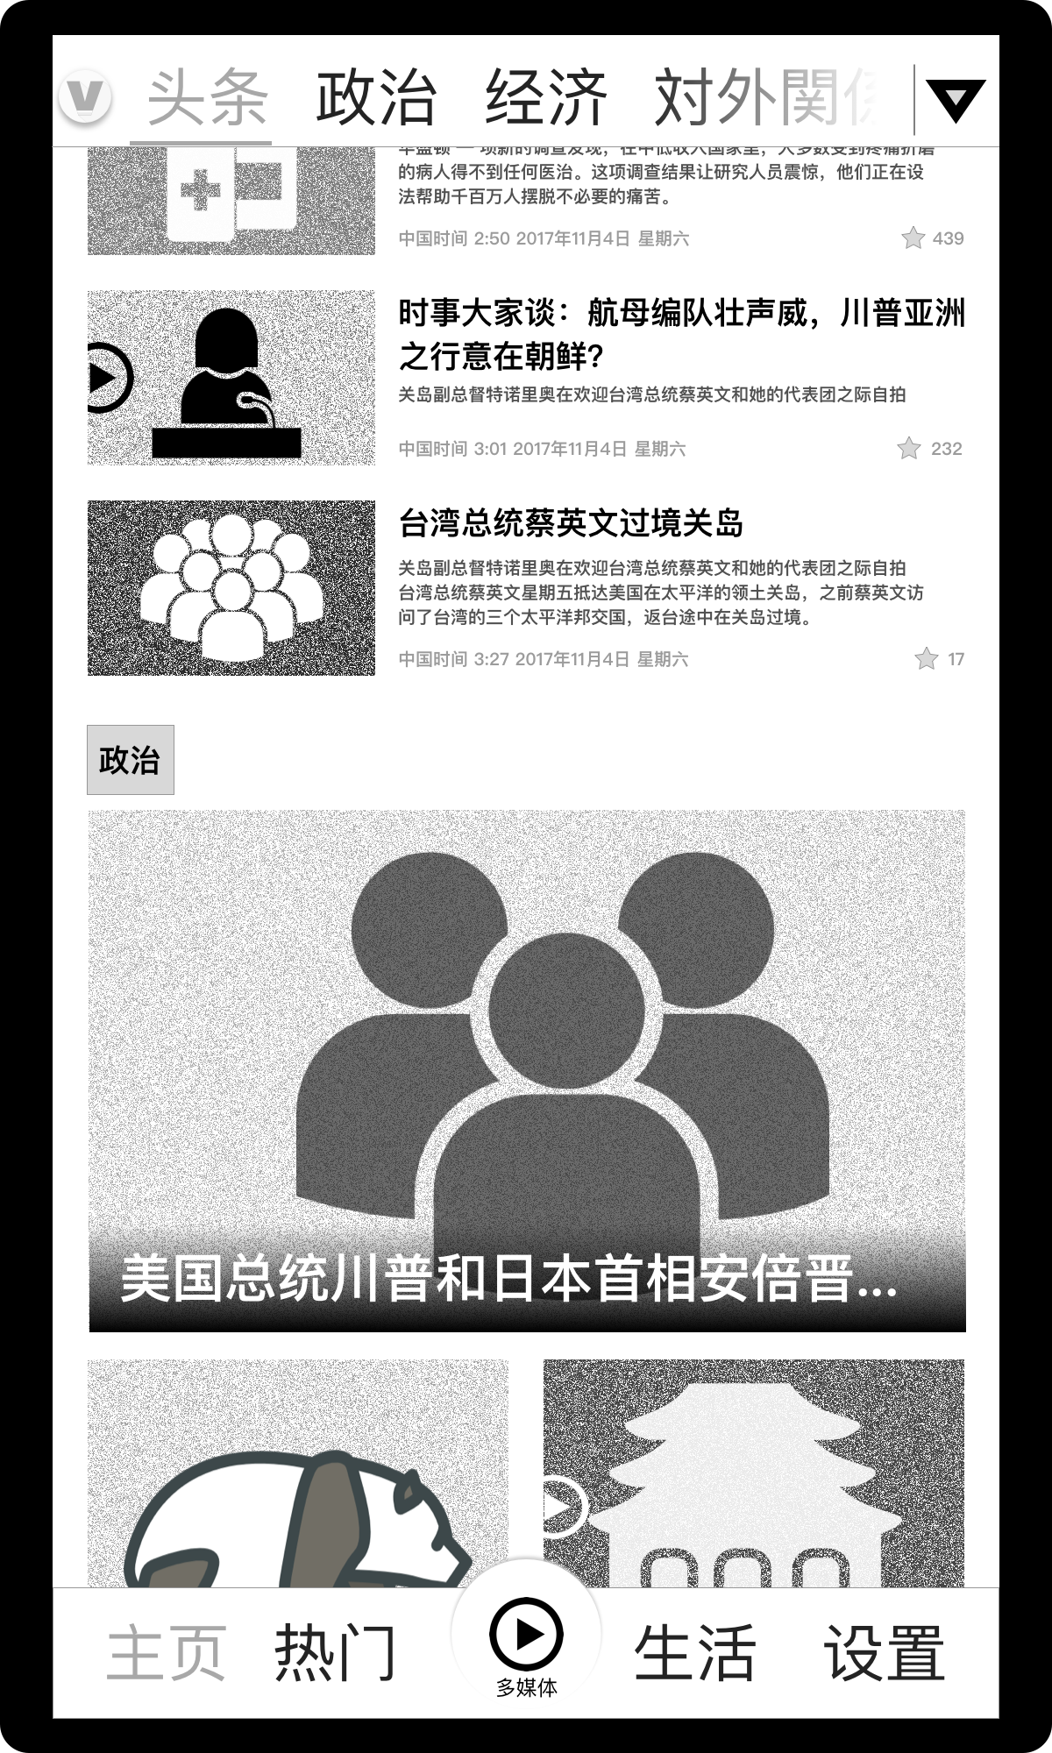
Home / Category Landing Swipe Left and Scroll Down

Slide 6

Category Landing
Individual Perspective
Personas
All
Time in Journey
8 to 18 seconds
Emotion
FOMO
Anticipation
Expectation
Tasks / Goals
Find out about the latest news in a particular category
Thinking
Where is the update I’m looking for?
Heuristics
Useful – I’m getting the right news
Controllable – I know how to find what I’m looking for
East of Use – It’s easy to get what I want
Software Perspective
Psiphon Connection
If connection is lost, show cached content for a set amount of time
Interactions
Scroll up for more content
Click into a story
Scroll down to reveal Search
Click Categories / Manage Categories
Scroll left / right to see more Categories
Click content
Click for different content types and user settings
Affordances
See available content
Hear content playing in multimedia player
Feel vibration when Psiphon is lost
Business Perspective
Hypothesis
Users get the categories of news they want
Users can easily figure out how to change their category prioritization
Business Value
Quickly give users the most up to date news in their preferred category
Metrics This Will Support
Adoption
Retention
Business Goals
Keep users engaged
Minimize the number clicks to get users to the news they want

Slide 7
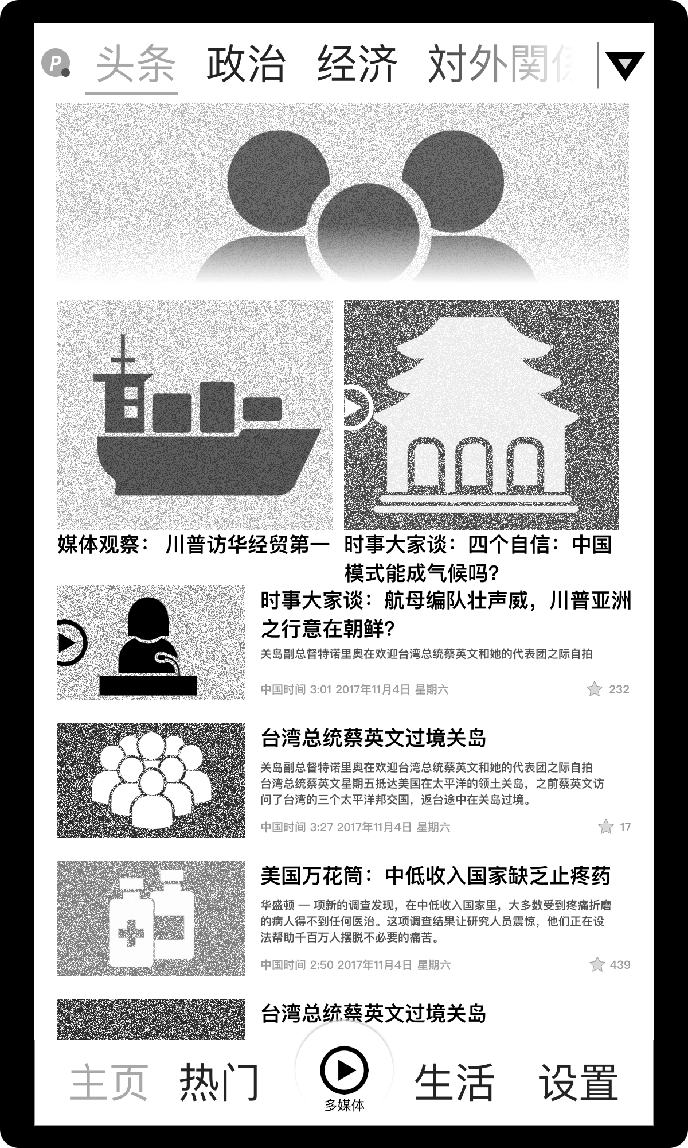

Category Landing Swipes
Swipe Up
Swipe Down

Slide 8

Single Text Article
Individual Perspective
Personas
All
Time in Journey
8 seconds to 2:08 minutes
Emotion
Satisfaction
Feeling informed
Wanting to interact with the content
Tasks / Goals
Read the news
Share, Favorite, Download
Thinking
I’m getting the news I want
I can interact with the content
Heuristics
Useful – I’m getting the right news
Controllable – I know where I am and how to read more news
Delightful – it’s easy to interact with the content
Safety – I still feel safe not being tracked
Software Perspective
Psiphon Connection
If connection is lost, show cached content for a set amount of time
Interactions
Scroll up for the rest of the content
Swipe left to go back to Home/Category landing page
Swipe right to go to next Related Content
Click to Share, Favorite, Download, or adjust Text settings
Affordances
See content
See list of Related Content
Feel vibration when Psiphon is lost
Hear OK Google / Siri read the article
Business Perspective
Hypothesis
Users want to see mostly text
Business Value
The screen cleanly presents content
Metrics This Will Support
Adoption
Retention
Business Goals
Quickly give users streamlined content
Give the ability to interact with content through sharing, favorite-ing, and downloading

Slide 9
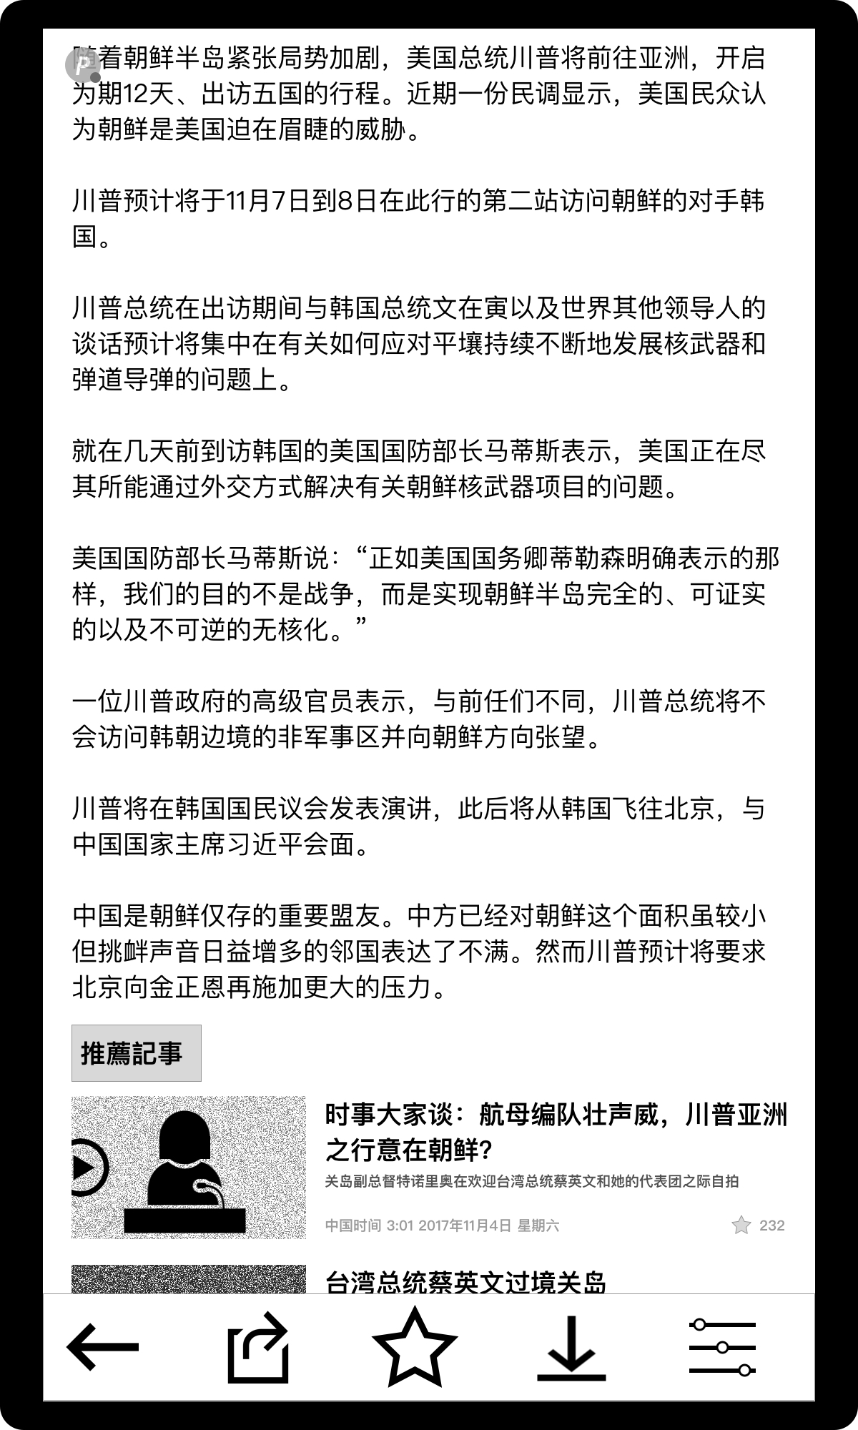
Single Text Article Swipe Up

Slide 10
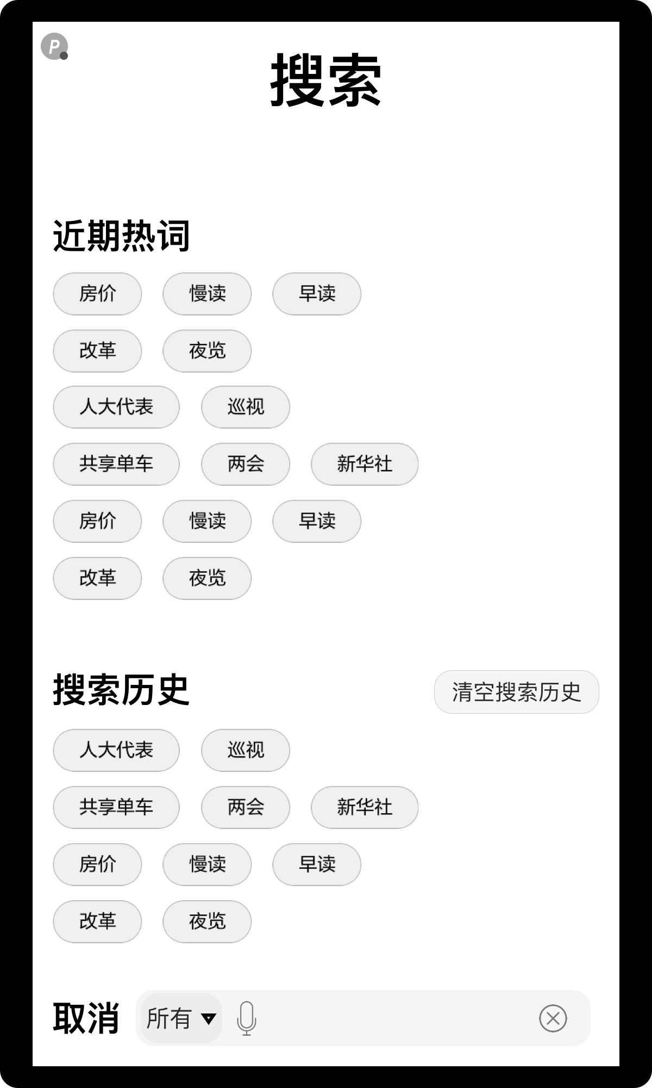
Search Input
Individual Perspective
Personas
All
Time in Journey
Mid-way
Emotion
Curiosity
Expectations
Tasks / Goals
Find the content I want
Thinking
I’m interested in a particular topic
Heuristics
Useful – I’m finding the right news
Controllable – I know how to search for the news I want and the news I’ve searched for in the past
Confident – I believe I’m getting search results that will lead to the content I want
Software Perspective
Psiphon Connection
If connection is lost, provide search history from the cached content
Interactions
Type or speak the search terms into the search bar
Click X to clear search input
Click “Cancel” or swipe right to return to previous screen
Click a “Search History” or ”Popular Searches” term-button
Click “Clear Search History” to clear list of previous search terms
Affordances
See list of previous search terms
See list of popular search terms
Speak to input search terms
Feel vibration when Psiphon is lost
Business Perspective
Hypothesis
Users want a simple way to search for articles about a particular topic (search term)
Users can understand having the search bar at the bottom
Business Value
Giving users search functionality and awareness of their search preferences
Enables VOA to understand the type of content users want
Metrics This Will Support
Adoption
Retention
Business Goals
Quickly give users access to the content they want

Slide 11
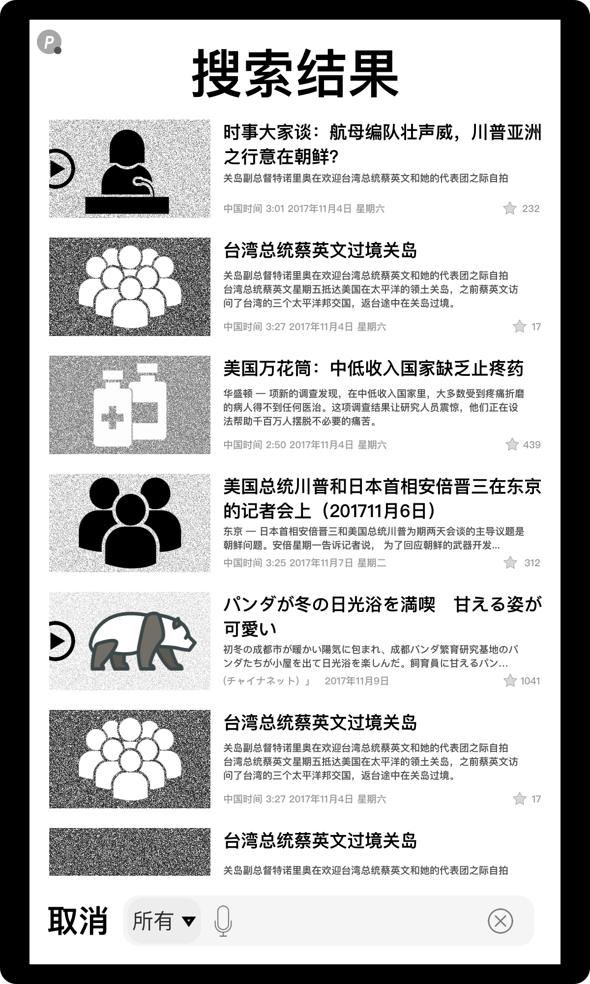
Search Results
Individual Perspective
Personas
All
Time in Journey
Mid-way
Emotion
Seeking
Satisfaction
Tasks / Goals
Hone in on the content I want
Thinking
I think I found what I want
Heuristics
Useful – I’m finding the right news
Controllable – I know how to scan the results
Confident – I know if the results are getting me to the right content before I click
Software Perspective
Psiphon Connection
If connection is lost, provide search results from the cached content
Interactions
Type or speak the search terms into the search bar
Click X to clear search input
Click “Cancel” or swipe right to return to previous screen
Click a search result to open it
Affordances
See list of previous search terms
See list of popular search terms
Speak to input search terms
Feel vibration when Psiphon is lost
Business Perspective
Hypothesis
Users want to see a thumbnail, headline, caption, date/time, and number of likes in their search results
Business Value
Enables VOA to understand the type of content users want and what metadata helps users decide on content
Metrics This Will Support
Adoption
Retention
Business Goals
Quickly give users access to the content they want

Slide 12
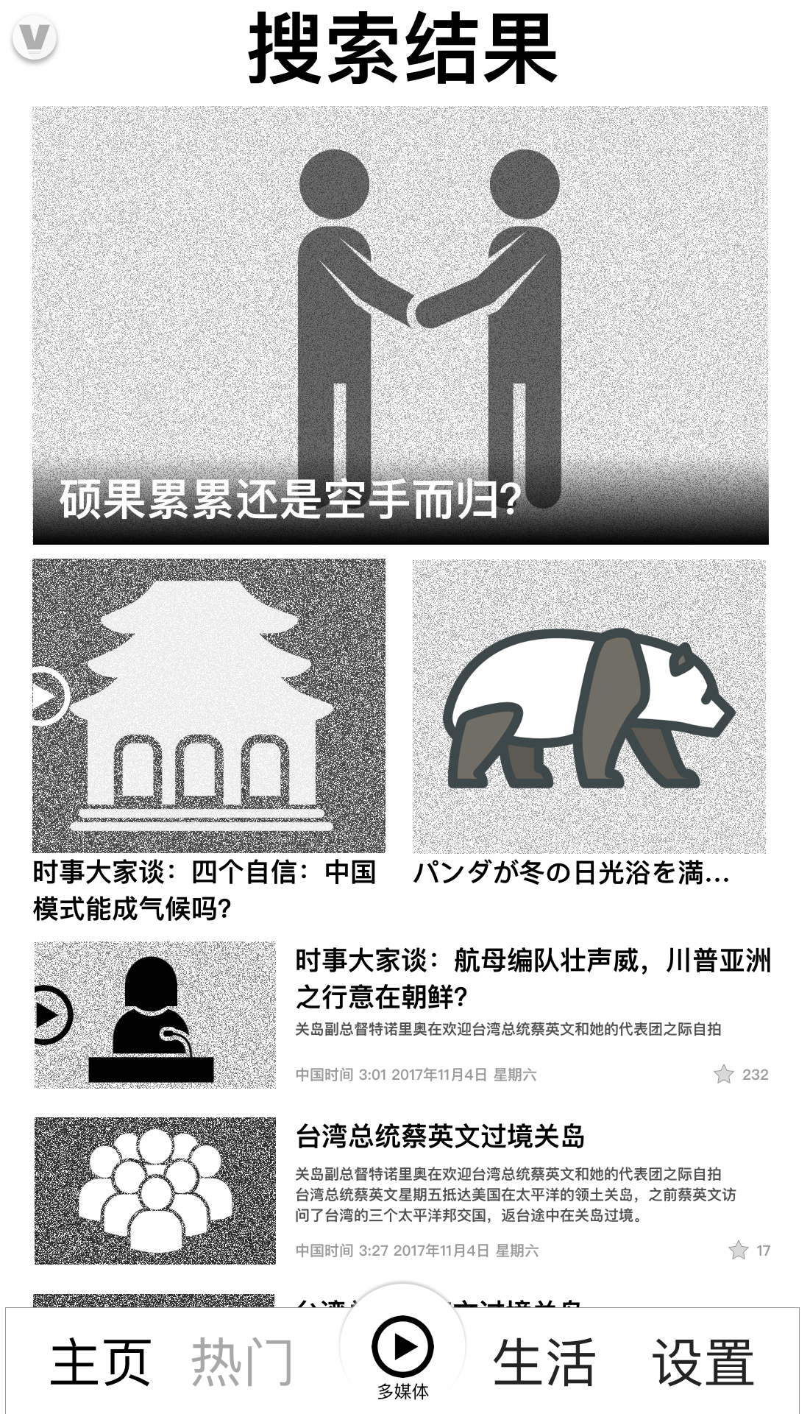
Breaking News
Individual Perspective
Personas
All
Time in Journey
8 to 18 seconds
Emotion
FOMO
Anticipation
Expectation
Tasks / Goals
Find out about the latest news in a hot topic / category
Thinking
What’s new?
Heuristics
Useful – I’m getting important news
Confidence – I know this is important news
East of Use – It’s easy to get what I want
Software Perspective
Psiphon Connection
If connection is lost, show cached content for a set amount of time
Interactions
Scroll up for more content
Scroll down to reveal Search
Affordances
See available content
Click into a story
Hear content playing in multimedia player
Feel vibration when Psiphon is lost
Business Perspective
Hypothesis
Users are interested in news that VOA editors consider “hot”
Business Value
Quickly give users stories on a new topic
Metrics This Will Support
Adoption
Retention
Business Goals
Keep users engaged
Minimize the number clicks to get users to the news they want

Slide 13
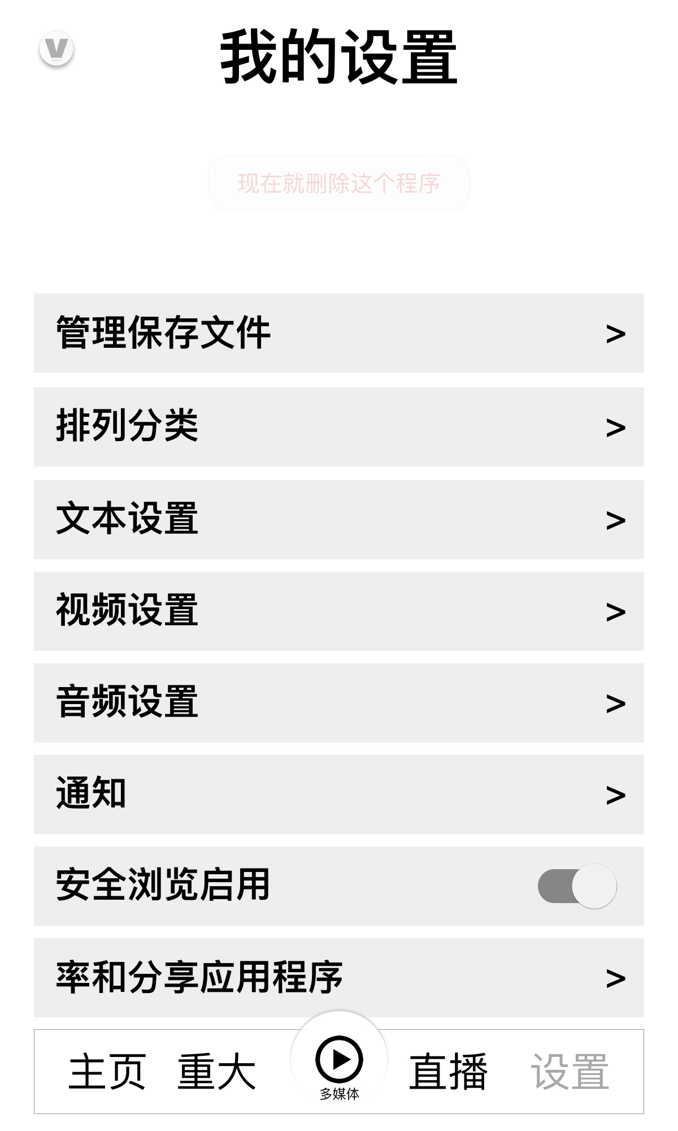
My Settings
Individual Perspective
Personas
All
Time in Journey
Only a few times throughout the lifecycle of the app
Emotion
Solve a usability problem
I want to make the app better for me
Tasks / Goals
Adjust the ways I get the news
Thinking
What can I customize?
Heuristics
Useful – I’m able to customize a lot of things
Controllable – It’s easy adjust things to my liking
Software Perspective
Psiphon Connection
If connection is lost, show cached content for a set amount of time
Interactions
Clicking any “Settings” button brings up a screen with multiple options
Affordances
See available Settings
Click into a Setting
Feel vibration when Psiphon is lost
Manage
Downloads
Manage
Categories
Text
Settings
Video
Settings
Audio
Settings
Notifications
Safe
Browsing
Rate &
Share
Business Perspective
Hypothesis
Users want to customize the way they access content
Business Value
Gives VOA insight into the different ways users engage with content
Metrics This Will Support
Adoption
Retention
Business Goals
Keep users happy
Keep users engaged with the content

Slide 14
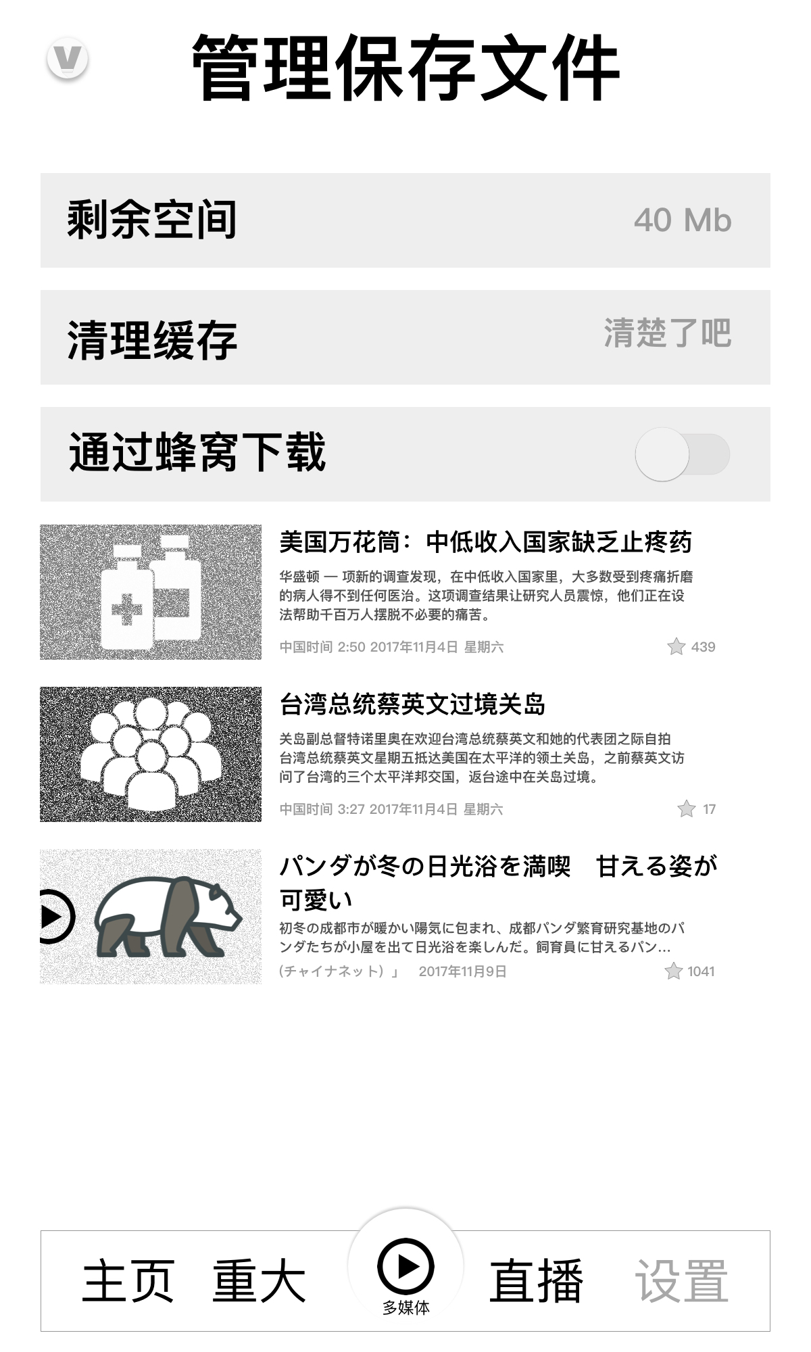
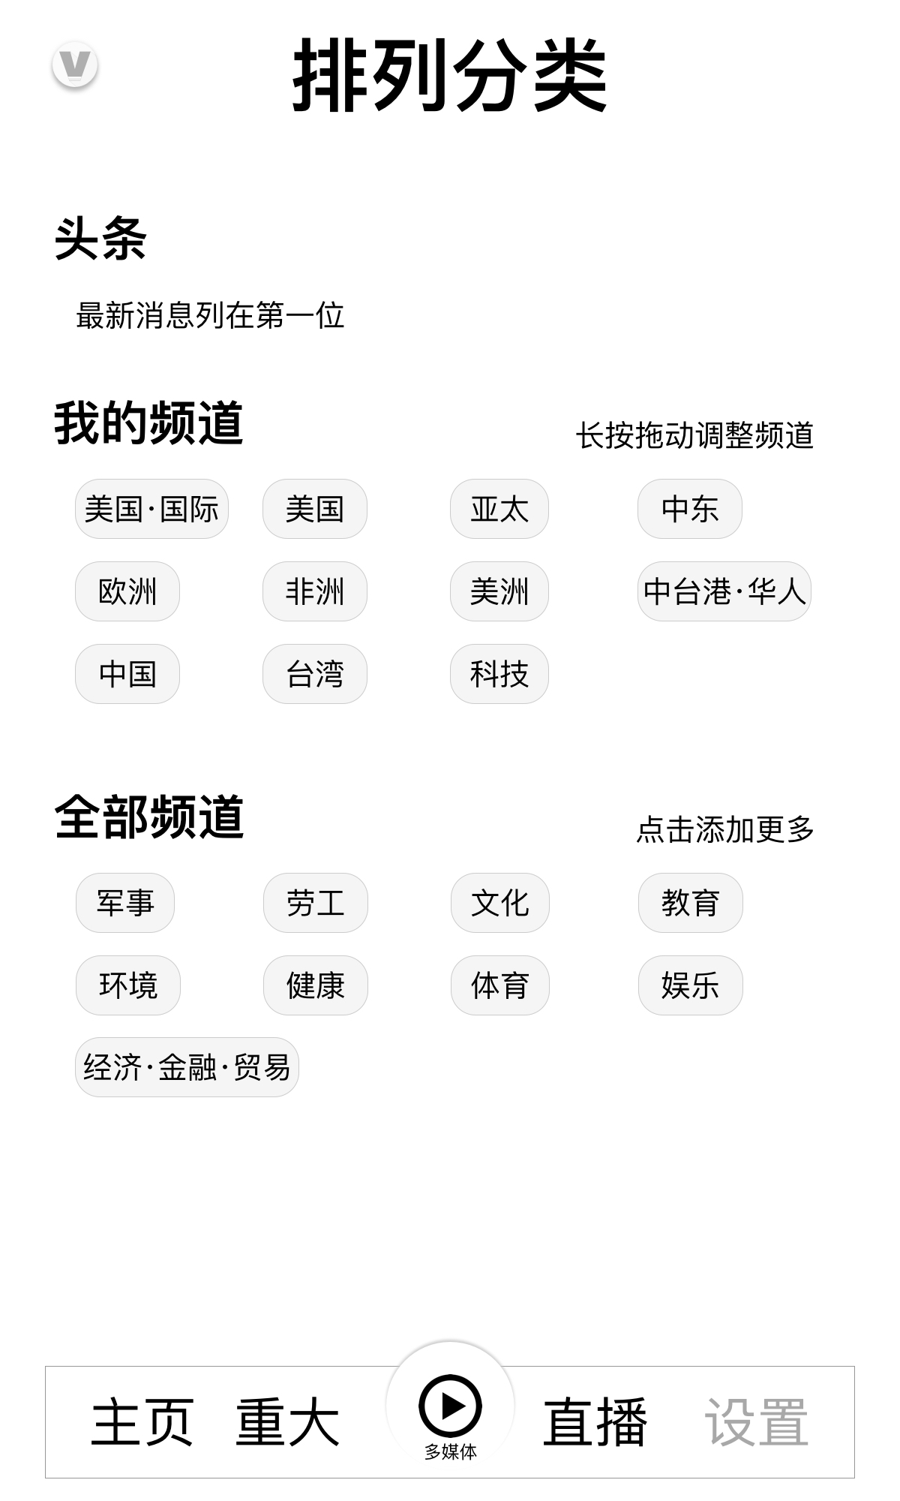
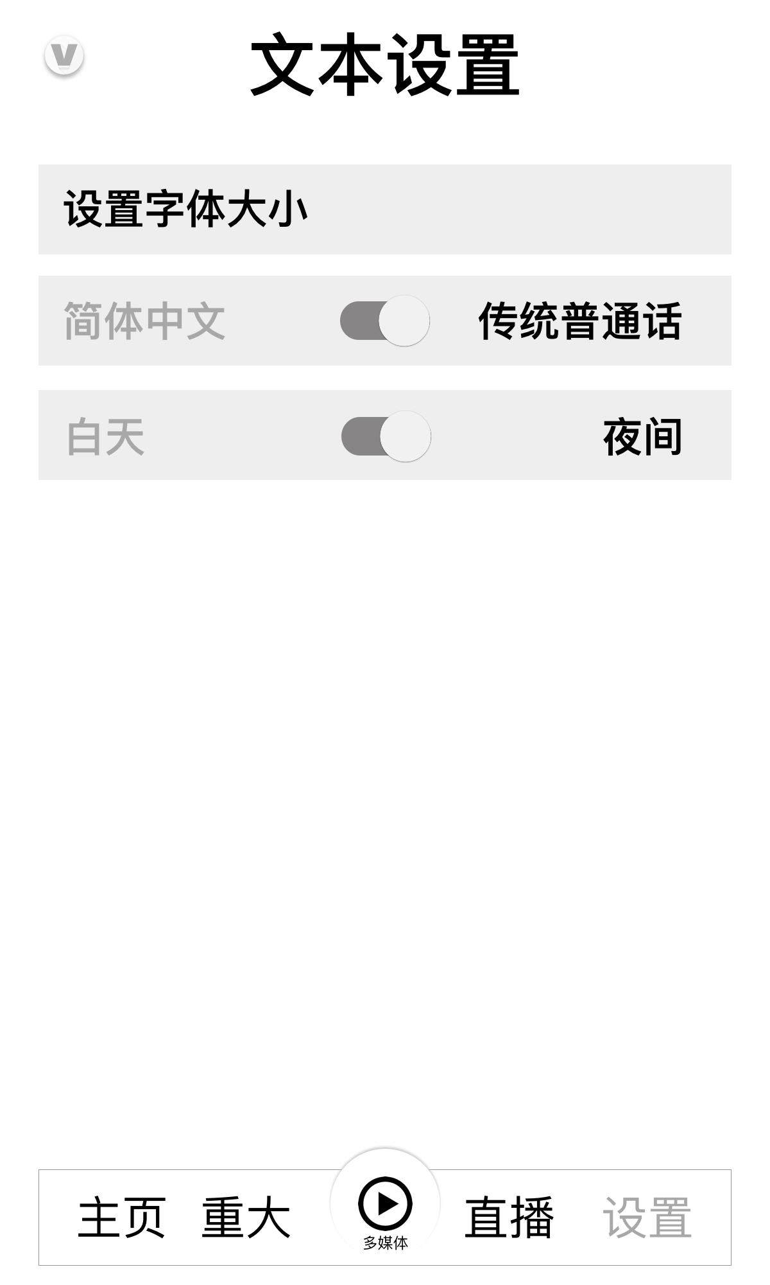
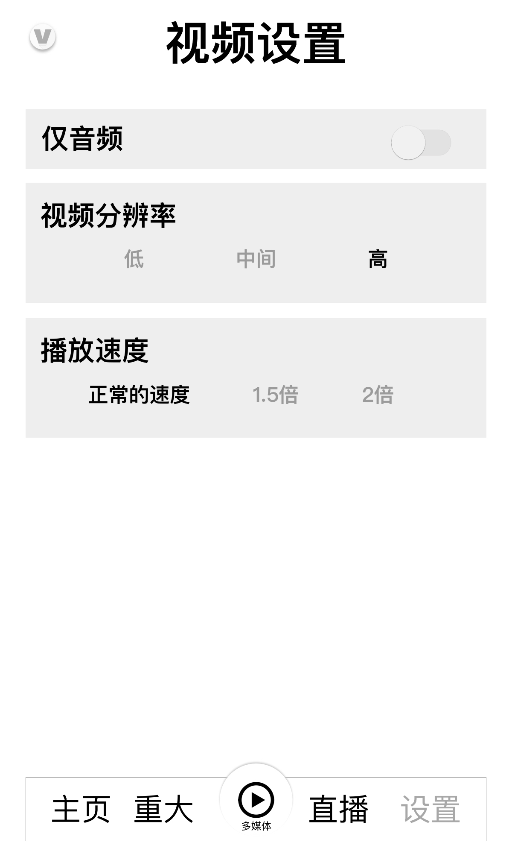
Various Settings
Manage Downloading Files
Category Manager
Available
Space Left
Clear
Cache
Enable
Cellular
Download
My Channel
All Channels
Text Settings
Video Settings
Size
Simplified or
Traditional
Daytime or Nighttime VIewing
Audio Only
Video
Resolution
Lo Med Hi
Video
Playback
Speed
Normal
1.5x
2x

Slide 15

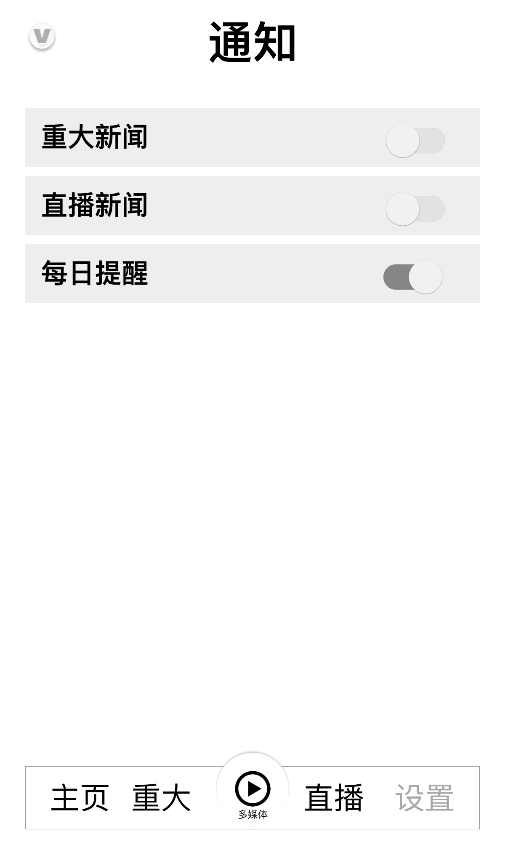

Various Settings
Audio Settings
Notifications
Audio
Playback
Speed
Normal
1.5x
2x
Major News
(Breaking)
LiveStream
Daily Alert
Rate and Share the App
Introduce
Us
Send
Feedback
Open mailto: <friend’s email>
Open mailto: VOA

Slide 16

Multimedia Player
Individual Perspective
Personas
All
Time in Journey
8 to 18 seconds
Emotion
FOMO
Anticipation
Expectation
Tasks / Goals
Hear / see the latest news
Thinking
What’s new?
Heuristics
Useful – I’m can easily scan important audio/video news
Confidence – I know this is the most up to date news
East of Use – It’s easy to figure out how to scan through the audio/video news
Software Perspective
Psiphon Connection
If connection is lost, show cached content for a set amount of time
Interactions
Click the image to reveal the full transport (shown on the next page)
Clicking the share icon allows users to share links to the audio/video
Clicking the ellipse reveals settings for video resolution and playback speed. Also has icons for favorite-ing and downloading.
Clicking the <15 or >15 buttons jumps the user backwards/forward 15 seconds
Clicking the related content below takes user to that content
Clicking the play button starts/pauses playback
Business Perspective
Hypothesis
Users want to see the parts of audio/video streams that are relevant to them.
Business Value
Take advantage of the audio/video production that VOA has available.
Metrics This Will Support
Adoption
Retention
Business Goals
Keep users engaged
Minimize the number clicks to get users to the portion of the live audio/video they want

Slide 17

Multimedia Player Image Tap

Slide 18
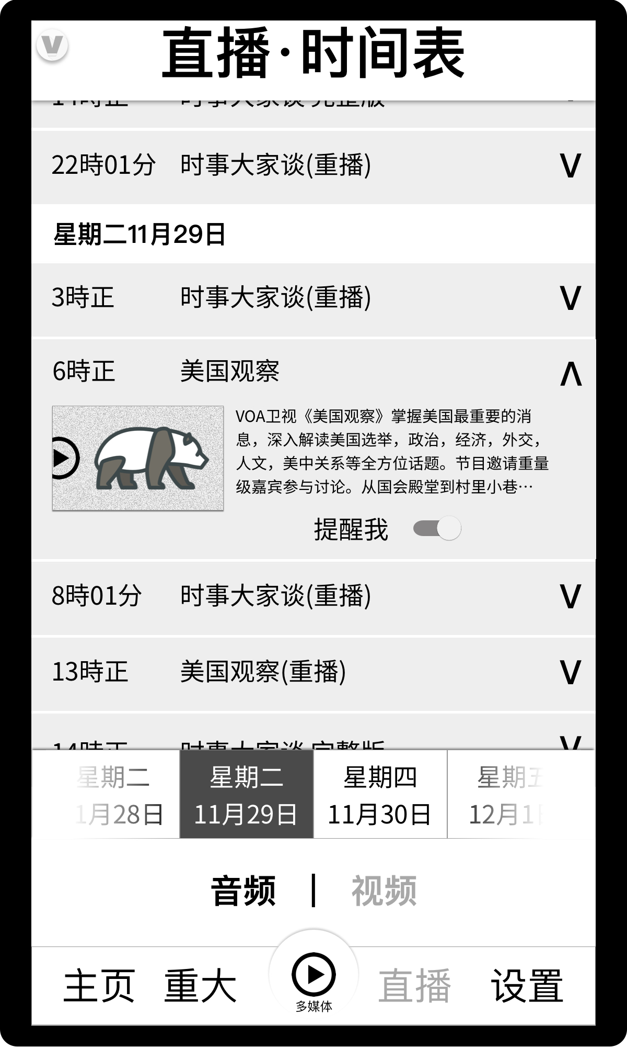
LiveStream Schedule
Individual Perspective
Personas
All
Time in Journey
8 to 18 seconds
Emotion
FOMO
Anticipation
Expectation
Tasks / Goals
Hear / see the latest news
Thinking
What’s new?
Heuristics
Useful – I’m getting important news
Confidence – I know this is the most up to date news
East of Use – It’s easy to figure out what past and present LiveStreams are available
Software Perspective
Psiphon Connection
If connection is lost, show cached content for a set amount of time
Interactions
Click either Audio | Video to choose the relevant schedules
Clicking the day of the week fast-scrolls the list to the beginning of that day
Swipe up to see LiveStreams later in the schedule
Swipe down to see LiveStreams earlier in the schedule
Click the V to get more details about a LiveStream
Click the ^ to close the details
Click the LiveStream’s image to go to the multimedia player and play the LiveStream
Slide the slider to turn on a reminder for that LiveStream
Feel vibration when Psiphon is lost
Business Perspective
Hypothesis
Users want to know about the upcoming (and past) LiveStreams. They want to listen to / view current LiveStreams and those from the past. They want to be reminded of upcoming LiveStreams.
Business Value
Take advantage of the audio/video production that VOA has available.
Metrics This Will Support
Adoption
Retention
Business Goals
Keep users engaged
Minimize the number clicks to get users to the live audio/video they want

